Slide 1
Ham Radio and Emergency Management
In Augusta County, Waynesboro, and Staunton
Thank You Dave Beebe K4UEK

Slide 2
This presentation is Not about
The structure and organization of Emergency Management in the state of Virginia
It is actually quite complicated and dynamic (Governors tend to change it occasionally)
A mix of State and Private (not for profit) organizations that are interconnected
Remember that ARES is an ARRL entity and totally unrelated to the State Emergency Management structure- the State could opt to engage ARES if they so desired but there is no formal mandate from what I could find.
Therefore, we are fortunate to be an invited member to our local LEPC (Local Emergency Preparedness Committee)

Slide 3
Local emergency preparedness committee: represented entities
Meets Quarterly
Fire, EMS, Police, Emergency Management, Emergency Communications, and local elected officials from Staunton, Augusta, and Waynesboro
Virginia Department of Emergency Management
Virginia Department of Environmental Quality
Virginia Department of Forestry
Augusta Health
Local HAM radio group
Central Shenandoah Health District (VDH)
American Red Cross
CERT
Western State Hospital
Woodrow Wilson Workforce Center
Blue Ridge College
Mary Baldwin University
SAW Schools
Central Shenandoah Planning District Commission
Local Industry
Citizen representative

Slide 4
Local emergency preparedness committee: Current participants
Adam Sheets, Wilson Work Force Rehabilitation Center
Amanda Irvine, Augusta County ECC
Andrew Holloway, Waynesboro Fire Department
Chad Kauffman, Staunton Police Department
Craig Strawderman and Gene Stewart, VDEM
Dave Beebe, Fred Castello, Augusta Health/Ham
David Shaw, Waynesboro Police Department
Donald Smith, Augusta County Sheriff
Gary Craun, Shenandoah Valley Airport
Gary Critzer, Waynesboro Emergency Management
Greg Schacht, Augusta County Fire and Rescue
Jonathan Knotts, Augusta Health
Julia Pilipenko and Robert Stinnett, Dominion Energy
Michael Shull, Augusta County Board of Supervisor
Nicholas King, Augusta County Service Authority
Pat O Neil, American Red Cross
Patrick Lam, Augusta County Emergency Management
Shannon Conner, Western State Hospital

Slide 5
LEPC Leadership
Chair: Gary Critzer (City of Waynesboro)
Vice Chair: Patrick Lam (County of Augusta)
Secretary: Jonathan Knotts (Augusta Health)

Slide 6
Example agenda items
Revision of SAW HAZMAT Plan
Update on implementation of P25 radios
Airport tabletop exercise
Ham radio at local hospitals
Augusta County 911 center renovation
Augusta County Sherriff discussed Active Attack training
VDEM discusses training events and exercises
Red Cross discussed installation of smoke alarms for visual and hearing-impaired folks

Slide 7

Ham Radio in Valley Hospitals

Slide 8
History of Ham Radio at Hospitals in the Valley
About 6 years ago a grant was obtained to facilitate the purchase and installation of ham radio equipment into about 12 hospitals up and down the valley
Recent merger into Northern Virginia Emergency Response System (NVERS) – they initiated bi-monthly communication drills that includes ham radio
Generally, there are antennas (HF folded dipoles and dual band VHF/UHF verticals) on the roofs of these hospitals
We exercise the radios once a week and participate in emergency planning and emergency exercises
Primarily use Winlink and PACTOR on HF and Packet on VHF

Slide 9
Why Have Ham Radio in a Hospital
Communication functionality of last resort
As a rule, when all else fails, ham radio can get through
You may recall hurricane Katrina in August of 2005
Some hospitals in very desperate situations (loss of power, supplies, staff, etc.)
After that, CMS thought it might be a good idea to have the ability to have backup communications.
Remember earthquake in Louisa in 2011
  As a result of that earthquake, UVA lost all of its internet capability
We believe if activated our primary function will involve facilitating the transfer of patients (in or out) and/or the communication of the facilities functionality

Slide 10
Participating hospitals
Augusta Health-Fishersville
Western State Hospital-Staunton
Bath County Community Hospital-Hot Springs
Carilion Rockbridge Community Hospital-Lexington
Sentara Martha Jefferson-Charlottesville
Sentara Rockingham Memorial-Harrisonburg
Shenandoah Memorial Hospital-Woodstock
UVA Culpepper Medical Center-Culpepper
UVA Medical Center-Charlottesville
Warren Memorial Hospital-Front Royal
Page Memorial Hospital-Luray
Winchester Medical Center-Winchester (and 2 of their WV Hospitals

Slide 11
Sample Forms We Might Use

Slide 12
Facility Status Report

Slide 13
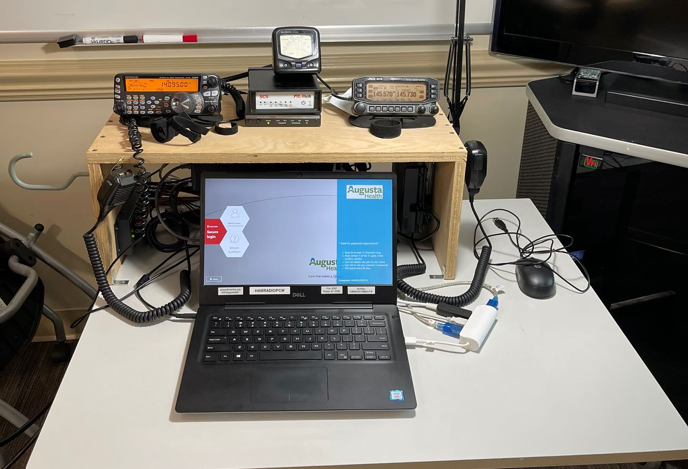

Slide 14
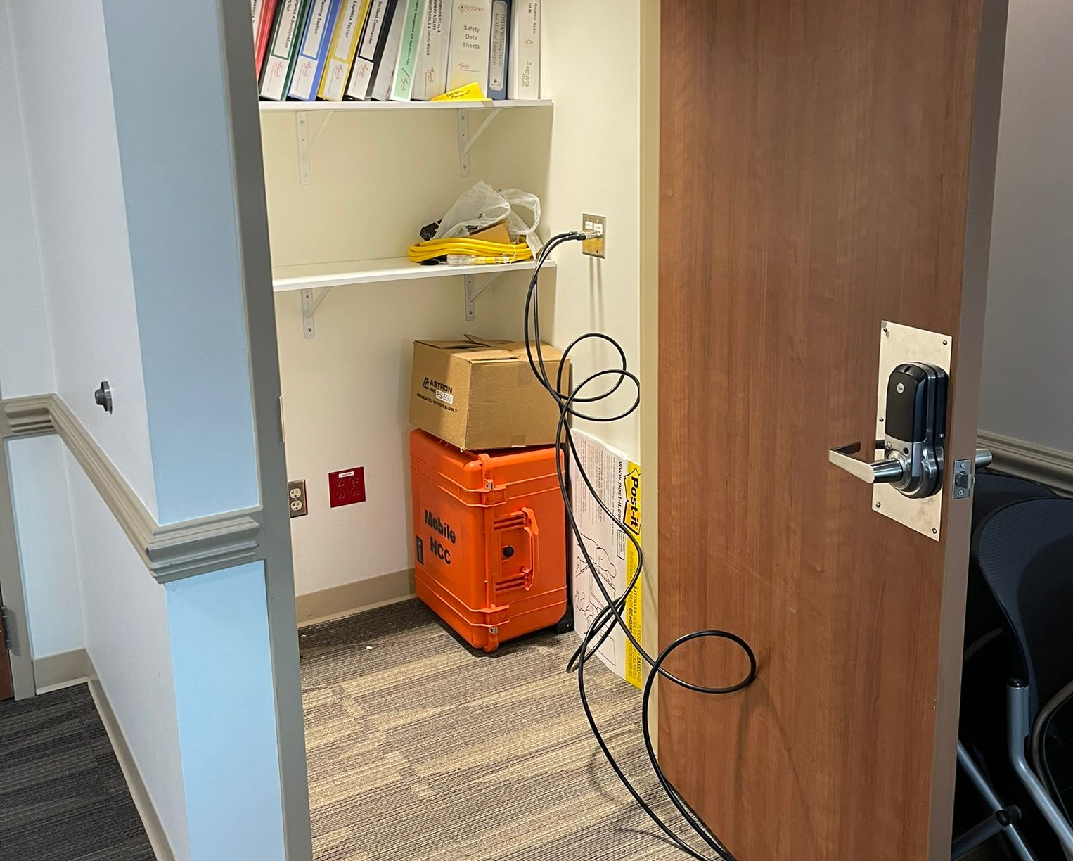

Slide 15
Questions/comments?

